Slide 1
Data quality workshop: getting it right – repairs, lettings, collection/arrears & satisfaction
Steve Smedley, Acuity

Slide 2
Agenda
1) Benchmarking basics – reminder
2) The definitions:
Lettings/voids
Collection & arrears
Repairs & maintenance
Satisfaction
Order your coffee now, you’ll need it

Slide 3
Benchmarking basics
benchmarking = comparisons
not everything that is performance managed needs to be benchmarked
so, the question is: will comparisons provide additional insight?
exploring variation in results to understand
why is it so? What’s the story?
what good looks like - different approaches/good practice
extent to which context is a factor
setting evidence-based improvement targets
to hold exec/board to account
less is more: best focus on getting a smaller number of key metrics right
how?: stick to the definition - might be different to how you traditionally count something
alternative?: undermines credibility of data & ultimately the sector – trust issues, corrosion, anarchy, zombie apocalypse
Notes:
It is
analytical biz tool to understand material cost & performance in context of your biz
where service scope, performance levels, operating environment (inc client group) & (in)efficiency are all cost drivers
high cost fine if investment is conscious decision, outcome is commensurate
enables considered human VFM judgements, options and robust decisions eg
target improvement action
target right allocation of resources
complements qualitative data: staff workshops/experience, TP/scrutiny, satisfaction, customer insight, complaints, stakeholder perception, service reviews, etc – to reach a rounded judgement
a transparency tool to demonstrate VFM to stakeholders
essential for non-commercial organisations (captured customers/monopolies)
a means of educating the ignorant about the extent of what you do ( ref Tory MPs!)
It is not
‘the answer’ or last word on VFM – ‘computer says no’
the data by itself means nothing without the story of ‘why it is so’
often as much about context as it is about performance, especially Global Accounts/RSH metrics
cost & performance, in the round, with other info, in context
a finely calibrated tool for
league tabling
getting hung up on immaterial/minor apportionment issues – they don’t change the headline
meant to expose individuals – requires supportive team response to collective/corporate issues

Slide 4
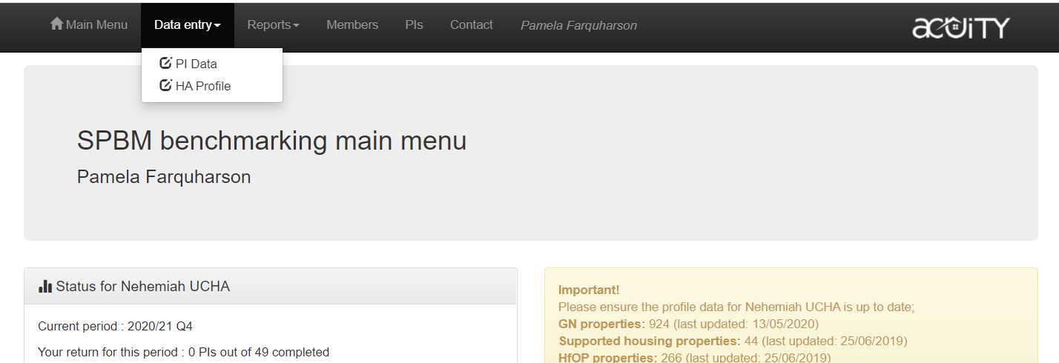
Benchmarking basics
focused on benchmarking the primary forms of managed social housing
= general needs, housing for older people & support (definitions on ‘profile’ page)
limited exceptions in financial metrics (eg overall margin, EBITDA)
we capture other info on your ‘profile’ page to provide essential biz context (eg other forms of housing, turnover, staffing levels) – useful when picking a bespoke peer group
when submitting end of year data, don’t forget to ensure your profile is up to date
Notes:
It is
analytical biz tool to understand material cost & performance in context of your biz
where service scope, performance levels, operating environment (inc client group) & (in)efficiency are all cost drivers
high cost fine if investment is conscious decision, outcome is commensurate
enables considered human VFM judgements, options and robust decisions eg
target improvement action
target right allocation of resources
complements qualitative data: staff workshops/experience, TP/scrutiny, satisfaction, customer insight, complaints, stakeholder perception, service reviews, etc – to reach a rounded judgement
a transparency tool to demonstrate VFM to stakeholders
essential for non-commercial organisations (captured customers/monopolies)
a means of educating the ignorant about the extent of what you do ( ref Tory MPs!)
It is not
‘the answer’ or last word on VFM – ‘computer says no’
the data by itself means nothing without the story of ‘why it is so’
often as much about context as it is about performance, especially Global Accounts/RSH metrics
cost & performance, in the round, with other info, in context
a finely calibrated tool for
league tabling
getting hung up on immaterial/minor apportionment issues – they don’t change the headline
meant to expose individuals – requires supportive team response to collective/corporate issues

Slide 5
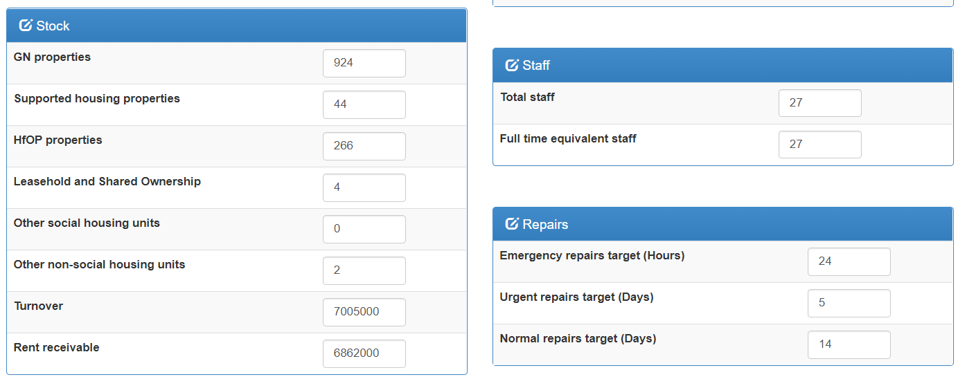

Slide 6
Benchmarking basics
benchmarking is the start of a journey not the last word
biz analysis tool (internal)
evidence-based resource allocation & focused improvement work
aim high - achieve ambition/mitigate risks in challenging circs – create headroom/buffer
transparency/accountability/political management tool (external)
provide assurance of sound grasp of cost and performance, in context, internally & externally
Past Biz Plan Review Cycle Future
Benchmarking results
+ other quantitative & qualitative data
Decisions
Further investigation, priorities, resource allocation, improvement action
Implement
Evidence-based Biz Plans & VFM Strategy/Action Plans
Analysis
What’s the story?
How are we doing?
Insight
Understand strengths, weaknesses, priorities
Notes:
achieve ambition
deliver your corporate plan, create headroom
maximise social goals at the heart of your mission
mitigate risks – preserve value (& reputation) in the face of challenging operating environment, political/economic uncertainty, etc

Slide 7
Benchmarking basics
it is not ‘the answer’ or last word on VFM – ‘computer says no’
limitation of metrics - data means nothing without the story of ‘why it is so’
often as much about context as it is about performance
cost & performance/quality in the round, complemented with other info (eg qualitative), taken in context
look at related metrics in conjunction eg:
arrears reduced at expense of void loss?
FTAs reduced by write-offs?
good average void & repair times at expense of satisfaction?
etc
not a finely calibrated tool for league tabling, getting hung up on immaterial/minor apportionment, exposing individuals
definitions can’t legislate for every eventuality – sometimes need interpreting based on what metric is trying to do – clubs a useful forum to discuss
TSM likely to change what benchmarking clubs collect going forward – worthy topic for summer meetings?: what should you ditch?
numerator = result
denominator
Notes:
It is
analytical biz tool to understand material cost & performance in context of your biz
where service scope, performance levels, operating environment (inc client group) & (in)efficiency are all cost drivers
high cost fine if investment is conscious decision, outcome is commensurate
enables considered human VFM judgements, options and robust decisions eg
target improvement action
target right allocation of resources
complements qualitative data: staff workshops/experience, TP/scrutiny, satisfaction, customer insight, complaints, stakeholder perception, service reviews, etc – to reach a rounded judgement
a transparency tool to demonstrate VFM to stakeholders
essential for non-commercial organisations (captured customers/monopolies)
a means of educating the ignorant about the extent of what you do ( ref Tory MPs!)
It is not
‘the answer’ or last word on VFM – ‘computer says no’
the data by itself means nothing without the story of ‘why it is so’
often as much about context as it is about performance, especially Global Accounts/RSH metrics
cost & performance, in the round, with other info, in context
a finely calibrated tool for
league tabling
getting hung up on immaterial/minor apportionment issues – they don’t change the headline
meant to expose individuals – requires supportive team response to collective/corporate issues

Slide 8
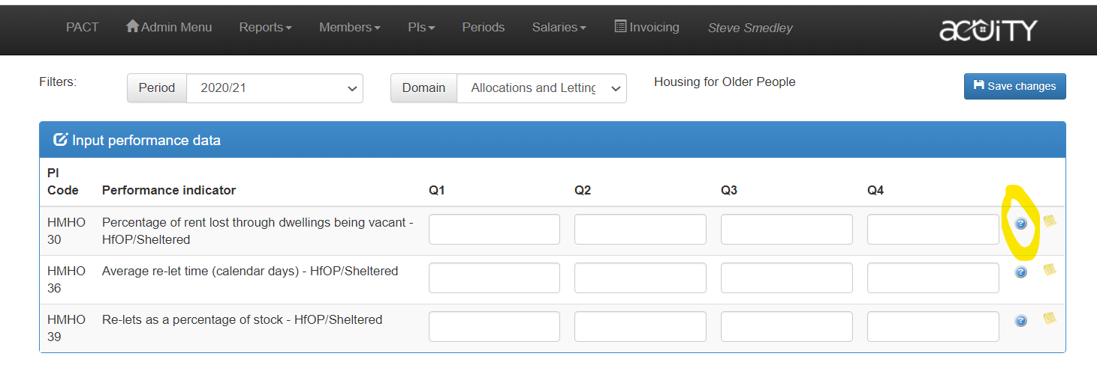
All definitions available on data entry page by clicking on the blue ‘?’

Slide 9
Key lettings/voids metrics
tend to be differentiated by client group (GN, HfOP, Support)
borrow heavily from CORE definitions
GNPI/HMHO/HMHS 30 series - Percentage of rent lost through dwellings being vacant
xxxx36 series + CMPI 03 + BV212 - Average re-let time (calendar days)
xxxx39 series - Re-lets as a percentage of stock
borrow heavily from CORE definitions
tend to be differentiated by client group

Slide 10
xxxx 30 - Percentage of rent lost through dwellings being vacant
Rationale: optimum use of social assets/revenue maximization, ROI foregone from unlet assets (Major Works included!)
calculation:
rent & service charges lost due to dwellings being vacant x 100
gross rent and service charges receivable
denominator - ‘gross rent and service charges receivable’ - total potential rent & service charges collectable for the period for all dwellings if all dwellings had been occupied
dwelling may have been vacant for any reason - includes dwellings that are ‘unavailable to let’ (eg MW & held for decant)
But…. if ‘unavailable to let’ are not expected to be let as social dwellings again, eg awaiting demolition, they should be excluded from both numerator & denominator (ie ignore completely)
if collecting 1/4ly
numerator - year to date rent/service loss
denominator – prorata annual rent/service charge
Watch out! – unlike average re-let time, you include MW

Slide 11
xxxx36 series + CMPI 03 + BV212 - Average re-let time (calendar days)
Rationale: efficiency of key biz process
Isolates the majority of voids - standard/routine re-lets
calculation:
total # days (standard relet) properties were vacant in period
# of (standard relet) lettings in period
‘# of days vacant’ = # days between tenancy end date and tenancy start date
calendar days – 7 days in a week
day property goes vacant does not count (nor day let………because it’s let!)
can get 0 days, can’t get negative
standard/routine? – no major works, new lets, successions, exchanges, voids held for decant in numerator or denominator
MW never ‘convert’ to standard/routine once work phase finished – always stay separate
definition of MW is critical (see next slide)
only include voids in this calc once let & include whole time, eg it may have become void in the previous reporting period
finally letting that long void has sting in tail!

Slide 12
…..so what’s a MW void?
differentiating between standard/routine void & MW void comes down to detailed definition of MW:
couldn’t reasonably be carried out with tenant in-situ – decant test = acid test
…..typically such work is necessary for property to remain habitable, eg
structural - essential to stability and weather resistance eg floors, walls and roofs.
site works to area around (typically safety & security)
services installations – gas, electric, water, heating, ventilation, lifts
work that significantly improves dwelling – this may be relevant to those who upgrade whilst property void (can the decant test be applied?)

Slide 13
xxxx39 series - Re-lets as a percentage of stock
Rationale: context for re-let time and void loss indicators, may indicate churn for whatever reason
Calculation:
number of properties re-let during the period x 100
number of properties managed
Definition- re-lets as a proportion of the units managed
exclude owned stock if not managed by you
as with void loss, include dwellings vacant for any reason except where not to be used as social housing again (eg awaiting demolition)

Slide 14
Key rent collection & arrears metrics
tend to be differentiated by client group
xxxx210 series + GNPI 28 - Rent collected as a percentage of rent owed (excluding arrears b/f)
xxxx220 series + CMCX13 - Current tenant arrears as a percentage of the annual rent debit
SWBM 400, 410, 420 - Rent arrears net of unpaid HB

Slide 15
xxxx210 series + GNPI 28 - Rent collected as a percentage of rent owed (excluding arrears b/f)
Rationale: efficiency of key process & income maximization/capacity
Calculation:
actual rent and service charge income received year to date x 100
actual rent and service charges due year to date
(nb ‘year to date’ is there for those who collect 1/4ly)
solely interested in effectiveness of current collection process (arrears metrics are more historic & especially suited to trend analysis over time)
possible to score over 100% if making headway into historic arrears
exclude garages completely (in numerator or denominator)
actual rent and service charge income received in the period (numerator)
no adjustments for: late HB payments, pre-payments or post-payments
(‘arrears net of HB’ deals with late HB….2 slides time)
other non rent/service charge items collected by landlord should be excluded if possible:
water rates, court costs, repairs recharges, overpaid housing benefit etc
if unable to split these out of rent collected, include them in both numerator and denominator.
actual rent and service charges due (denominator) – exclude
rent lost due to properties being vacant – exclude void loss (only count tenanted properties)
current tenant arrears brought forward at the beginning of the year - only arrears here should be from current year

Slide 16
xxxx220 series + CMCX13 - Current tenant arrears as a percentage of the annual rent debit (total arrears)
rationale: effective arrears process/income maximisation – particularly useful over time (trend)
calculation:
actual current tenant rent & service charge arrears at period end x 100
annual rent/service debit for current financial year (exclude void loss)
exclude:
void loss from denominator (as previous metric)
court costs/sundry debts, garages (as previous metric)
arrears from previous tenancy, FTAs – only interested in current rent/service arrears
advance payments/credits (masks true arrears - not your £ - they can ask for it back)
no adjustment for late HB (see next metric ‘arrears net of HB’ – it deals with ‘technical’ arrears)
denominator nerd alert for quarterly people
Q. if collecting quarterly, how the devil do you provide annual rent debit for current financial year, excluding void loss?…..you don’t know what voids you’ll get!@~#
A. whatever you have @ quarter end for rent debit excluding void loss is projected forward
at Q1 I have £100,000 rent debit minus £1000 void loss = £99,000
at Q1, 13 weeks have elapsed so £99,000/13 gives me a weekly rent debit minus void loss of £7615 (if Q2, it would be 26 weeks)
if I multiply £7615 by 52, I get a projected annual figure of £395,980

Slide 17
SWBM 400, 410, 420 - Rent arrears net of unpaid HB
rationale, calculation & definition: as previous metric but this allows you to adjust for the HB cycle – it deals with ‘technical’ arrears
simply exclude arrears due to late Housing Benefit payments

Slide 18
Key repairs & maintenance metrics
repairs metrics apply across GN, HfOP & Supported housing
SWBM 201 Average number of responsive repairs per unit
HMPI 101 Percentage of repairs completed at the first visit
HMPI 90 Average end-to-end time for all reactive repairs
‘% repairs completed on target’ suite:
HMPI 70 Percentage of all reactive repairs completed within target time
GNPI 18 Percentage of emergency repairs completed within target time
GNPI 19 Percentage of urgent repairs completed within target time
GNPI 20 Percentage of routine repairs completed within target time
HMPI 102 Percentage of residents satisfied with the most recent repair
G15C0 Percentage of dwellings with a valid gas safety certificate
G15C1 Percentage of gas safety checks completed within target

Slide 19
SWBM 201 Average number of responsive repairs per unit
rationale: as much about context as performance? Useful can opener.
High number: poor diagnostics, poor application of repairs policy, poor quality or simply about tenant or stock profile?
calculation:
Total number of responsive repair orders issued during the benchmarked period .
Total number of GN, SH & HfOP units where the landlord is responsible for responsive repairs
definition of ‘reactive’ (or ‘responsive’) is key:
all minor, ad hoc/unplanned repairs (regardless of priority)
that are reported by tenants or
arise from damage/wear and tear to communal areas and common parts
defect that is the landlord's responsibility to make good (as per Landlord and Tenant Act 1985)
counting jobs rather than SOR lines – a number of SOR tasks might be batched up into 1 job
not an exact science – especially if local practice involves batching lots together as part of annual visit
can be teased out in a group - extent some members have composite orders or include/exclude handymen type repairs
exclude
repairs undertaken as part of a pre-determined maintenance programme eg gas (cyclical)
including making good type repairs following cyclical works (if you can split them out)
void repairs

Slide 20
HMPI 101 Percentage of repairs completed at the first visit
formerly Percentage of repairs completed right first time
metric has its problems
was trying to expose poorly diagnosed, trained, organized and equipped council services back in 2000s (aimed to encourage multitrade operatives in vans with parts)
tweaked over time to address perceived unfairness but now feels clunky
fails to pick up that many small HA tenants happy for operative to nip to B&Q for parts
definition says that this should not be counted because operative left & returned = 2 visits
this metric discounted by RSH in TSM consultation
calculation:
# response repairs completed by operative without need to return a second time x 100
all responsive repairs completed (emergency, urgent & routine)
now allows for multiple trade visits where essential and known in advance
where job requires multiple trades, work completed first visit so long as each trade completes in one visit as planned
exclude totally:
diagnostic pre-inspections (no intention of repairing) – metric is about remedial action only
no access
?????arguably communal repairs??????

Slide 21
HMPI 90 Average end-to-end time for all reactive repairs
supersedes old school ‘% repairs completed on target’ (3 time bands in next slide) on basis that:
old school - can set different targets for ‘% repairs completed on target’ not a great basis for benchmarking!!!!!!
a timely service is ‘what tenants want’
shorter average suggests efficient process (but not satisfaction of course!)
calculation:
sum of the total number of calendar days taken to complete responsive repairs in the period
total number of responsive repairs completed in the period
definition:
average number (calendar) days between responsive repair being requested and its satisfactory completion including the day of request and the day of completion
date of satisfactory completion - decided by the landlord

Slide 22
‘% repairs completed on target’ suite
HMPI 70 Percentage of all reactive repairs completed within target time
GNPI 18 Percentage of emergency repairs completed within target time
GNPI 19 Percentage of urgent repairs completed within target time
GNPI 20 Percentage of routine repairs completed within target time
calculation:
sum of the total number of calendar days taken to complete [band] responsive repairs in the period
total number of [band] responsive repairs completed in the period
(ir)Rationale: as noted, with exception of emergency repairs, looks a bit dated
originally conceived in 2000s to kick councils up backside
OK to measure internally but comparing performance against targets when those targets might differ isn’t really ‘benchmarking’ (controversial perhaps)
list of repairs for the various bands but ‘local’ wiggle room too – further undermines benchmarking
kept alive by boards?
should you be benchmarking this (bar emergency)? – have a think

Slide 23
HMPI 102 Percentage of residents satisfied with the most recent repair
now adopted by STAR as one of new core questions
as such should conform to STAR method (covered at satisfaction section)

Slide 24
G15C0 Percentage dwellings with a valid gas safety certificate
Rationale:
assure all parties that landlord is complying (or otherwise) with the legal requirement to check and service all landlord owned gas appliances in their properties
avoiding prison
Calculation:
number of dwellings with a current valid gas safety certificate as at the end of the period x 100
number of dwellings the landlord has a gas safety obligation under the Gas Safety Regs
Definition:
landlord must have copy of cert
denominator
number of rented dwellings in ownership that have a connected gas supply (not necessarily the total stock in ownership)
where gas supply disconnected, these units are excluded from the denominator (landlord must hold an appropriate record confirming disconnection)
tenanted properties with disconnected gas pipework should only be excluded if there is a record of annual checks to verify the gas supply is still disconnected

Slide 25
G15C1 Percentage gas safety checks completed within target
similar but more challenging than previous snapshot
with previous - lots of safety checks might fall out of 12 month deadline but you pull out all stops to have 100% on 31 March
G15C1 – more onerous – identifies where a safety check has exceeded 12 months at any time in the year………
makes you put in place a systematic process ahead of 12 month expiry
calculation:
number of dwellings where a gas safety check was completed within 12 months of the previous one x 100
number of dwellings where a gas safety check was due under the Gas Safety Regs

Slide 26
Satisfaction
surveying practice beyond scope of this session
Basic calculation:
number of respondents who are very or fairly satisfied x 100
total number of respondents to question
primary satisfaction metrics from STAR – you should adhere to the methodology here eg
questions phrased specifically
5 response categories (with neutral middle)
appropriate sample size for perception and transactional type Qs
for small organisations this is tough – it might mean a census rather than a sample! ie you survey everyone!
online sample size calculator or (easier) handy spreadsheet included with these materials
data collected as part of a methodologically sound STAR survey - results good to go
remaining non-STAR satisfaction metrics are very transactional, eg satisfaction with ASB, complaints, etc
small number of cases - will skew results (begs question of comparing them) but qualitative feedback useful
advent of TSMs – adhere to RSH guidance/harmonisation with STAR?
Acuity is a key survey provider
we can help you get it right end-to-end (from deciding what to ask – to analysis and actionable insight)
provide 3rd party assurance
Notes:
Perception upto 1000 = Up to 278
Transactional
Under 100 ±10% 49 49%
+ 100 to 199 ±10% 49 to 65 49% to 33%
200 to 499 ±8% 86 to 116 43% to 23%
500 to 999 ±6% 174 to 211 35% to 21%

Slide 27
TSM timetable
Spring – Summer 22 | RSH analyses feedback from consultation
Late Summer 22 | RSH publishes decision statement, TSMs and technical guidance in anticipation of1 April 2023 implementation date. (Acuity plans to incorporate metrics so that members can pilot TSMs 2022-23 if they wish)
Autumn 22 -Spring 23 | Providers prepare systems
April 2023 - March 2024 | Providers collect first year of data
Summer 2024 | Providers submit data to regulator
Autumn 2024 | RSH publishes 2023-24 provider data

Slide 28
Get in touch about any further issues
steve.smedley@arap.co.uk
07814 424426

