Slide 1


Developing An
IT Strategy
To Meet Your Needs and Resources

Slide 2
About us
Specialist housing ICT & finance consultants
Expertise from inside and outside sector
Lessons learned to create bespoke solutions
Notes:
3C are one of the largest provider of salaried ICT consultants to the social housing sector. We have worked with over 150 different housing associations over the last 5 years, some that are now recognised as being leaders in digital business transformation. We are ideally placed to assist providers achieve their strategic ambition through ICT.
SHORTLISED BY THE NHF FOR THE BEST EXTERNAL PROFESSIONAL ADVISOR
I myself don’t originally come from the sector. For 18 years I was MD of two IT Services businesses. In 2008, when the banking crisis hit, we were forced to change our operating model to improve profitability and performance without impacting service. Better use of technology (new systems and a customer portal) transformed the way we operated. There were no redundancies, but over the next 5 years the business grew by over double and yet we only took on two additional members of staff in the contact centre.
3C's mission statement is "To empower people to deliver social value". This sits at the core of the services we provide, mentoring teams to continue our work after we have gone.

Slide 3
Housing Association’s have a greater impact on our communities and the stability of the next generation than almost any other type of organisation
Notes:
from other sectors

Slide 4
Technology is having a greater impact on the way Housing Associations supply their services then ever before
Anytime Anywhere
Notes:
across housing and from other sectors

Slide 5
"Every sector is built around long-standing, often implicit beliefs as to how to operate. They are often considered inviolable - until someone comes along to violate them. Almost always, it's an attacker from outside the sector."
McKinsey Consultants

Slide 6



What the customer wants
Notes:
The sector as a whole is lagging behind most other sectors when it comes to use of technology and internet based services. Many other sectors have had to change radically. Some internet based organisations that didn’t even exist 20 years ago, are now some of the largest companies in the world. Amazon is anticipated to become the world’s first 3 trillion dollar business this year.

Slide 7
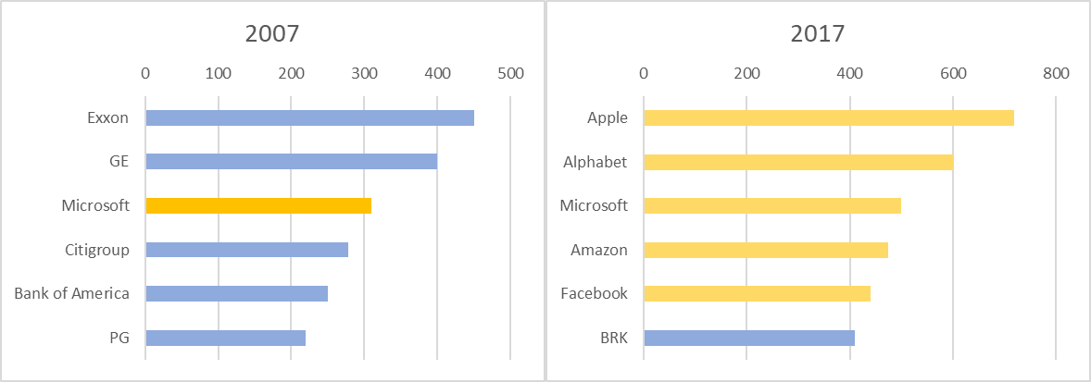
The Age of Technology

Slide 8
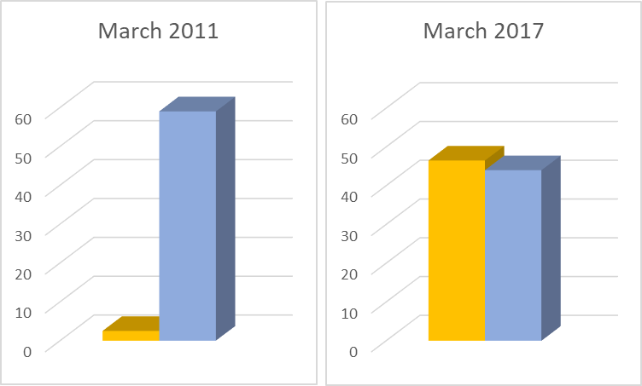


The Tesla Factor
2,500
cars
4.9m
cars
84K
cars
6.7m
cars
Notes:
How could driverless cars impact communities?

Slide 9

Notes:
Spotify – heralded as the new way of listening to music…. And yet I’ve just cancelled my subscription in preference of Amazon Music
When it comes to offering what are now already proven services over the internet, denial is not an option. Online services have to be a part of your strategy. You no longer need to be a pioneer. Proven formulas now provide a blueprint to follow. Achieving internal cultural change is now in my view the biggest challenge.

Slide 10

Voice
Estimated 8m units sold
in 1st 2 years
100% CAGR
Number of Alexa Skills
Jan 16 130
Aug 17 2,000
Jan 17 7,053
Dec 17 25,000

Slide 11

New ways of working
X Server hardware
X Server software
ü Services over fast, resilient broadband
Do Management Want To:
X Own It
X Run It
ü Make Best Use Of It
Stay completely focused on your business

Slide 12


The 3C Model
Notes:
My company 3C has no servers and does almost everything in the Cloud
Our maintenance and support costs are minimal
365 costs me less than £10/mth per user and Sage costs me £25/mth
…. And yet I can fulfill all the compliance, DR and data security requirements that were previouslu enjoyed by only major corporates
Our software is all online and the only IT we own are laptops, printers and smartphones
We benefit from levels of security, compliance, DR and business continuity that use to be reserved for major corporates….. At a fraction of the price.

Slide 13








Software Sector Transformation

Slide 14
What does good look like?
Accelerating shift to digital services
Enabling new customer service strategy
Enhancing stakeholder engagement
Transformation of working practices
Notes:
We are all changing the way we live our lives, ever increasing our use of digital services.
(Justify by surveying audience as to who would now prefer to book a restaurant table by phone)
And the benefit is not just for us. The restauranteur now can take bookings 24x7 and they are not interrupted while preparing food or laying the tables.
We are changing the ways we ourselves want to deal with the people we take services from, so we need to embrace this opportunity to change and engage with our own customers differently

Slide 15
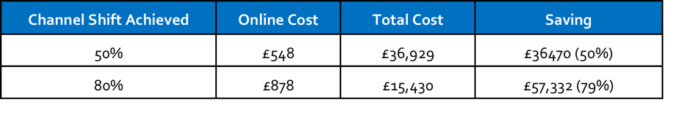
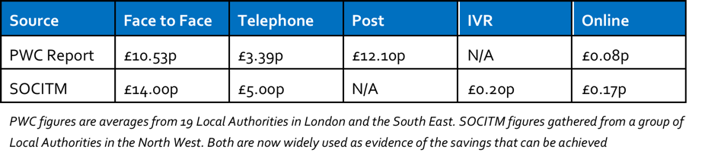
Doing more with less
Combined cost of phone and reception based communication was
£72,762 in 2014
Notes:
So how significant are these potential savings?
It is widely reported that the cost of transacting online with a customer is only a few percent of that of the more traditional channels. This effectively means that if you can shift 50% of your transactions online, savings could be in the region of 50%.

Slide 16
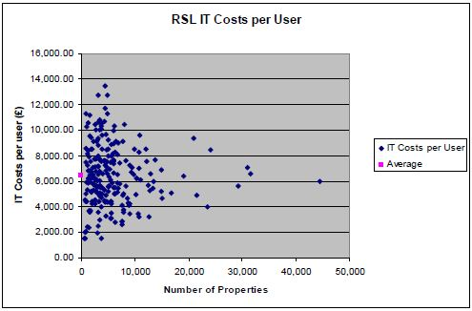

What Is The Potential?
“This level of unexplained variation must be due to differences in operating efficiency”
“We will be reinforcing our focus on VfM regulation and will increasingly be challenging providers”
Julian Ashby
HCA Chair
Notes:
Letter to HA Chairs from Julian Ashby
Since, benchmarking has started to receive greater focus.
LIBBERATING STAFF – not redundancy

Slide 17

Spotlight on Governance
Requests for
Governance Audits
Notes:
Grenfell
Collection of service charges
Luminus
GDPR
Retention and disposal of data - minimise what you collect - back-up and security

Slide 18
Spotlight on governance
Cash
Need to be able to collect 3x as much without it costing more
Audit
IDA’s and HCA audits
Notes:
We also need to address major new challenges.
UC, now scheduled to be fully in place by 2022, will mean that we have to collect 3x more cash that we’ve had to. Automated digital credit control processes are standard for many organisation.
It probably comes as no surprise that we have seen an increased focus on data governance since the Grenfell tragedy. The HCA have also confirmed that if you have over 1,000 units and haven’t had an audit, it’s coming. IDA’s/audits require accurate, accessible, but secure data and this also sits at the heart of offering customers digital, self-service. Get one right and you will be ready for the other.

Slide 19
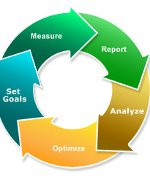
Data
Is The New Oil

Slide 20
Barriers to excellence
Systems integration
Manual processes
Digital exclusion
“We need cars, not faster horses”
David Orr - CEO of NHF (February 2016)
Notes:
There are challenges
We need to integrate our software systems so that to customers they appear as a single system
We need to change our operating processes
We need to attract our customers to engage with us online, assisting those that struggle
TECHNICAL SKILL AND UNDERSTANDING AT EXECUTIVE LEVEL
This is not about making minor changes, it is about making fundamental changes to the way we operate. As David Orr said at the NHF IT Conference…We need cars, not faster horses.

Slide 21
Culture eats technology for breakfast
Most common reason digital transformation fails is the failure to address cultural adoption
In almost half of all cases of failure, cultural change at Executive level was given as the primary reason.
A Gartner report on executive best practice has stated that they should allocate their time as follows:
  66% Operational
  20% Improvement activities
  14% Innovating

Slide 22

My Home - True self-service
Majority transact online
Portal fully integrates
Key Tenant Programme
Notes:
Example and in my view the leading light:
Elha introduced a new customer portal that integrates the HMS (SDM), workforce automation (Kirona Optitime), Reapirs (Northgate Responsive Repairs) and payment (WorldPay). 3C assisted in facilitating this process.
It is fairly straight forward to integrate with other scheduling tools, repair pickers and payment gateways - they are just individual modules that can be switched as required.
Worked started January 2016. My Home fully live January 2017. Website, elha.com, has also been spruced up and given a fresh new look.
True self-service has arrived, with tenants able to file and retrieve their own documents, make rent payments (which instantly update rent statements), book and confirm their own repair appointments, check their calendar for bin dates, stair cleaning dates, make repair appointments and so on, as well as get information about their home such as how to use their heating systems or where to locate their stopcocks.
Behind the scenes, administration is reduced as tenants take on basic administrative tasks such as filing, maintaining their own tenancy records, posting rent payments and booking repair appointments – all without any involvement from staff. Paper free status makes the mail room more efficient, and the automatic filing system means time can be spent on more productive tasks – but more importantly with tenants able to see documents the instant they are created, there’s no more waiting for the postman!
The new services have taken 18 months to design, deliver and test, but as they have been developed in partnership with the Association’s software suppliers, SDM, the new Digital Module is now available for other SDM customers to adopt, the introduction of the portal to other customers will be far quicker.
Chief Executive, Martin Pollhammer, said
“Developing My Home has been a fantastic journey for us, and we’re delighted with the results – they are much better than we ever hoped for. We now start the process of watching, learning and adapting as our tenants start to use our services, and we change the way we do our business. We know we have entered a slightly strange but wonderful world – and we are ready to do some exploring.”

Slide 23
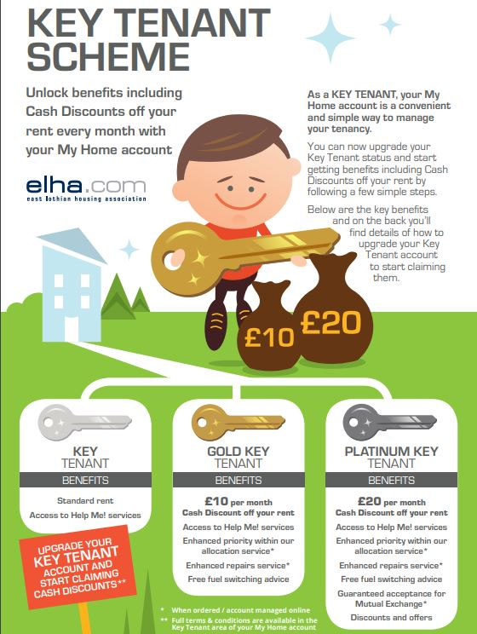
Gold
Activate My Home Account
Signed up for Paper Free
Rent paid by standing order or direct debit
Kept any repair appointments
Platinum
Activate My Home Account
Signed up for Paper Free
Rent paid by standing order or direct debit
Kept any repair appointments
Rent account up to date
No other tenancy breaches
TIG Web Member

Slide 24
33% of tenants are now Gold or Platinum
58% of all transactions are now online
100% repairs through My Home
Workforce automation
Figures from January 1018

Slide 25
My Home running costs per tenant = 7 stamps
Customisation relatively cheap
SDM selling module
It will integrate with almost any software
Elha – Further pioneering developments expected

Slide 26

Affordability
Elha’s Total Budget to create
My Home
£60,000

Slide 27
Successful IT Strategy
3 common characteristics
Customer centric
Know your customers and have a close and dynamic relationship with them
Data-led insight
Use data driven intelligence to improve both efficiency and service
Leadership
Champion digital services whilst having power and ability to achieve cultural change

