Slide 1
Innisfree Housing Association
Anne McLoughlin, Chair

Slide 2
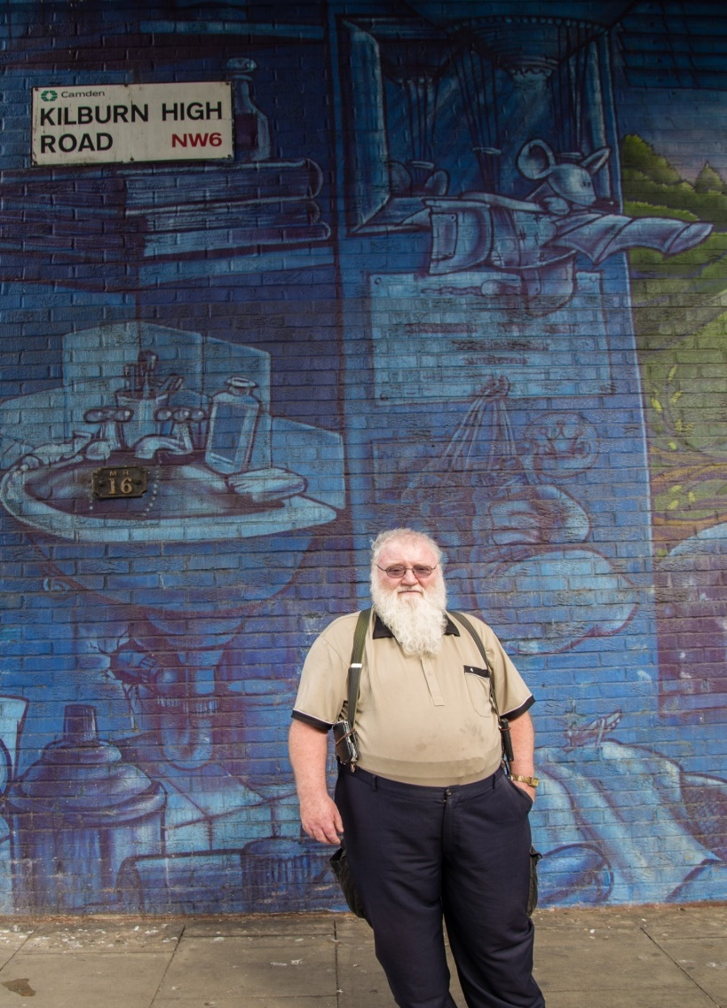
Innisfree
Founded 1985 by Irish advice agency
Now 550 homes Brent, Camden and Haringey
Two thirds of our tenants are Irish

Slide 3
Our Governance
KNOW WHO
KNOW WHAT
KNOW WHEN
KNOW US
KNOW HOW
Notes:
Know who you are as an organisation – we know our social purpose
Know what you are going to do to achieve that purpose – we have a comprehensive 3 year strategic plan that we monitor and update annually
Know how you are going to do that – We have high performing management in place – governed by a board with the right skills mix
Know when to take action – to verify and probe and when to delegate – triangulate information – and promote learning from mistakes and opportunities
Know us – culture – designed or evolved – there is one and the board leads it
And back to know who you are

Slide 4
‘Some of the largest housing associations who manage most of the social housing stock have moved away from being locally rooted and responsive to specific communities’
Models of Accommodation Report (Praxis et al 2015)

Slide 5
Know Who We Are
Passionate about the Irish contribution to London and UK
Confident about our financial strength and capacity
Ready for change
Our heritage – a special understanding
around new migrants

Slide 6
Know What We Will Do
Confident in our mission & plan
Manager and developer of quality homes
Pipeline – 50 new homes
Customer Satisfaction ambition
Our distinct identity generates different opportunities
Partner Irish Embassy
Notes:
We were set up to meet the needs of one migrant community, let’s do more of that with migrant communities today

Slide 7
Know How
We govern like someone is watching!
Simplified and streamlined Board
Open recruitment of new Board members
Emphasised our difference – our Irish identity
Notes:
Did away with subcommittees to operate as a unified Board, Cycle of meetings: operational one meeting then strategy the next
Annual appraisals as per NHF Code
Individual objectives set for Board members

Slide 8
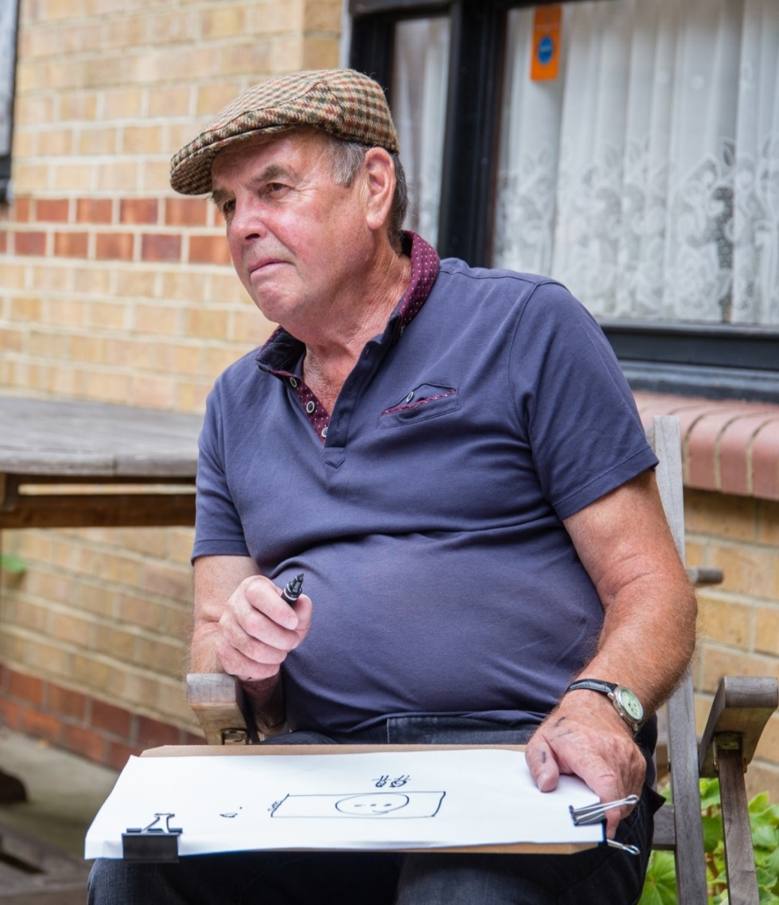
Know When
Open to independent assessment
Start & Finish Development group – manage risk
Strategy & Performance meetings

Slide 9
Know Us
‘Culture eats strategy for breakfast’
Courageous leadership
Encourage innovation
MSc research on temporary accommodation
New Direction and Influence
Founded ‘The Migrant Pledge’
Now National
First Syrian families arrived 8th March
Notes:
Culture is either designed or evolved – but there is always a culture. So though planning for the future essential – and a key job for the Board..
..so is designing and living the leadership culture, together with the leadership team
So at Innisfree

Slide 11
Our Governance
KNOW WHO
KNOW WHAT
KNOW WHEN
KNOW US
KNOW HOW
Notes:
Know who you are as an organisation – what's our social purpose
Know what you are going to do to achieve that purpose – a strategic plan
Know how you are going to do that – with the right management in place – governed by a board with the right skills mix
Know when to probe – triangulate information – and promote learning from mistakes and opportunities
Know us – culture – designed or evolved – there is one and the board leads it
And back to know who you are

Slide 12
Conclusion
On a journey – continuous improvement
Yet to replace tenant members
Confident about the reasons for independence
Equipped to manage risks and opportunities

